Slide 1
PRAGMA28 Students Workshop
Quan (Gabriel) Zhou, Meilan Jiang and Pongsakorn U-chupala
on behalf of the PRAGMA Students Group
The 28th PRAGMA Students Workshop, Osaka, Japan, Apr. 8th, 2015

Slide 2
Introduction to PRAGMA Students
Background
PRAGMA22 launched a discussion of how to engage graduate students more actively in PRAGMA.
The PRAGMA student group was formed in 2012 to shape and grow the opportunities for students that are inherent in PRAGMA’s long-lived trusted social network, and strong breadth of technical expertise.

Slide 3
Introduction to PRAGMA Students
Goal
Develop technically knowledgeable, culturally inclusive, and interdisciplinary scientists capable of leading global research.
Opportunities
Provided Education and mentoring
Generate its own network and be a vehicle for leadership opportunity
Infuse new ideas to PRAGMA and discuss with experies

Slide 4
PRAGMA Students Activities
Student Workshop
Invited talks
Lightning talks
Practice your presentation skills, Connect with mentors
Poster Session
Call for poster
Review posters with Senior Scientist
Organize Poster Session
Student Session in main workshop
Present outstanding student work
Show your idea to the group, Connect with peers
Distributed Seminar
Contact lecturer
Organize online seminar
Learn from expertise, Became an expert

Slide 5
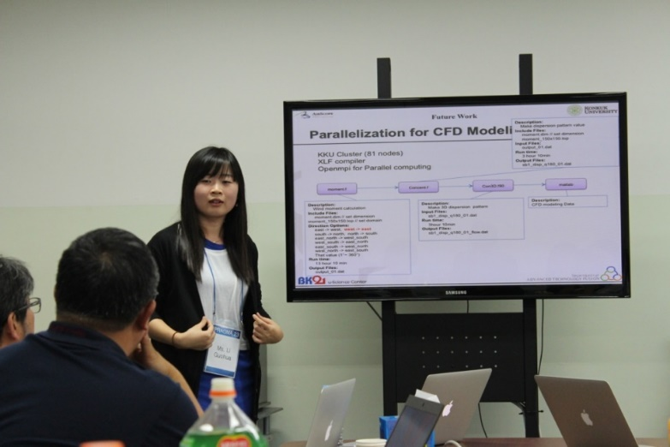
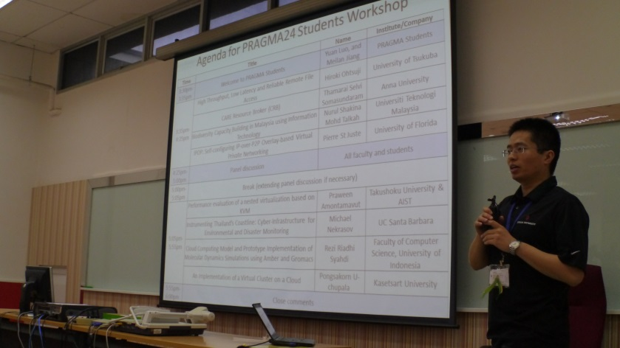
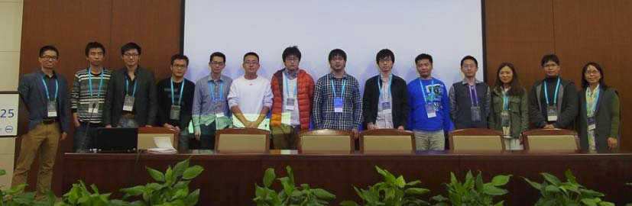
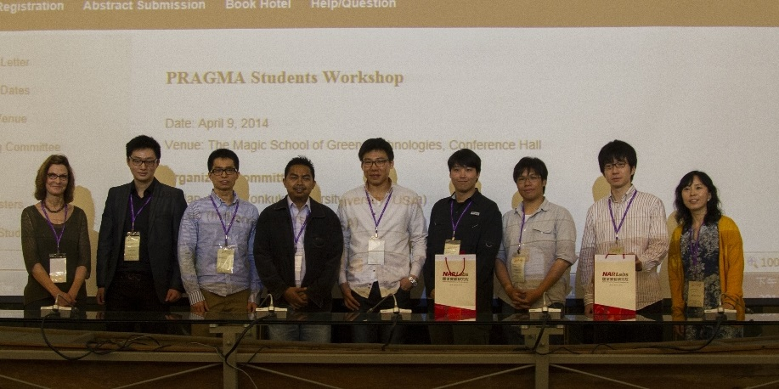
Student Talks
The 1st student workshop,
Seoul, Korea
The 2nd student workshop,
Bangkok, Thailand
The 3rd student workshop,
Beijing, China
The 4th student workshop,
Tainan, Taiwan

Slide 6
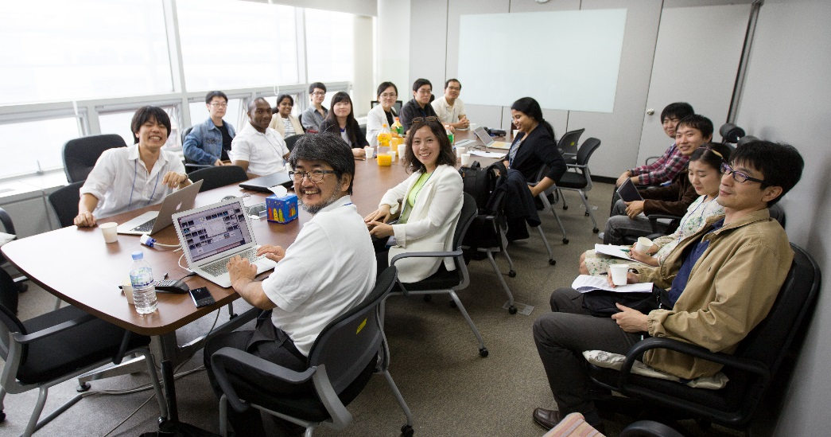
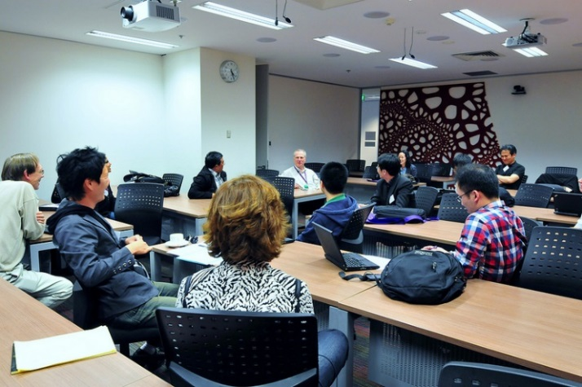
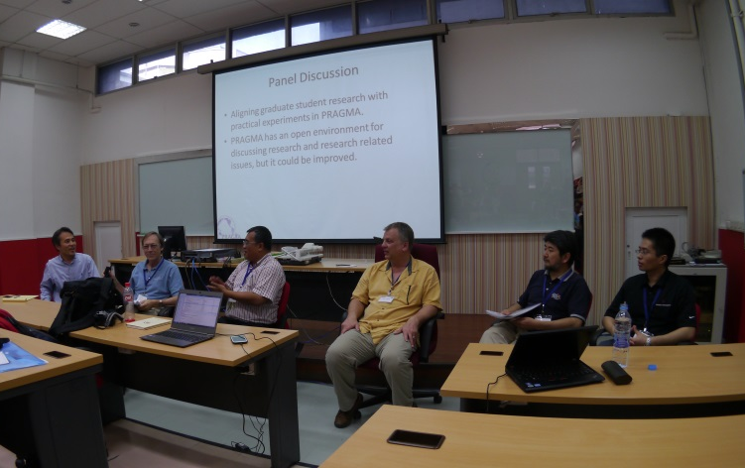
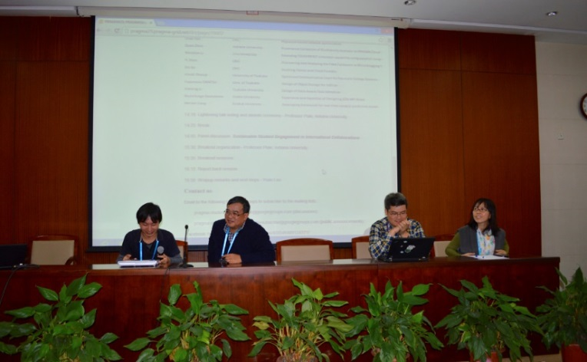
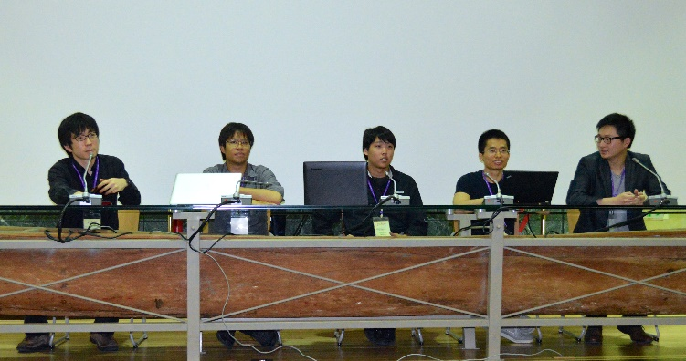
Group discussions with mentors
Pre-workshop conversation Melbourne, Australia
The 1st student workshop,
Seoul, South Korea
The 2nd student workshop, Bangkok, Thailand
The 4th student workshop,
Tainan, Taiwan
The 3rd student workshop,
Beijing, China

Slide 7
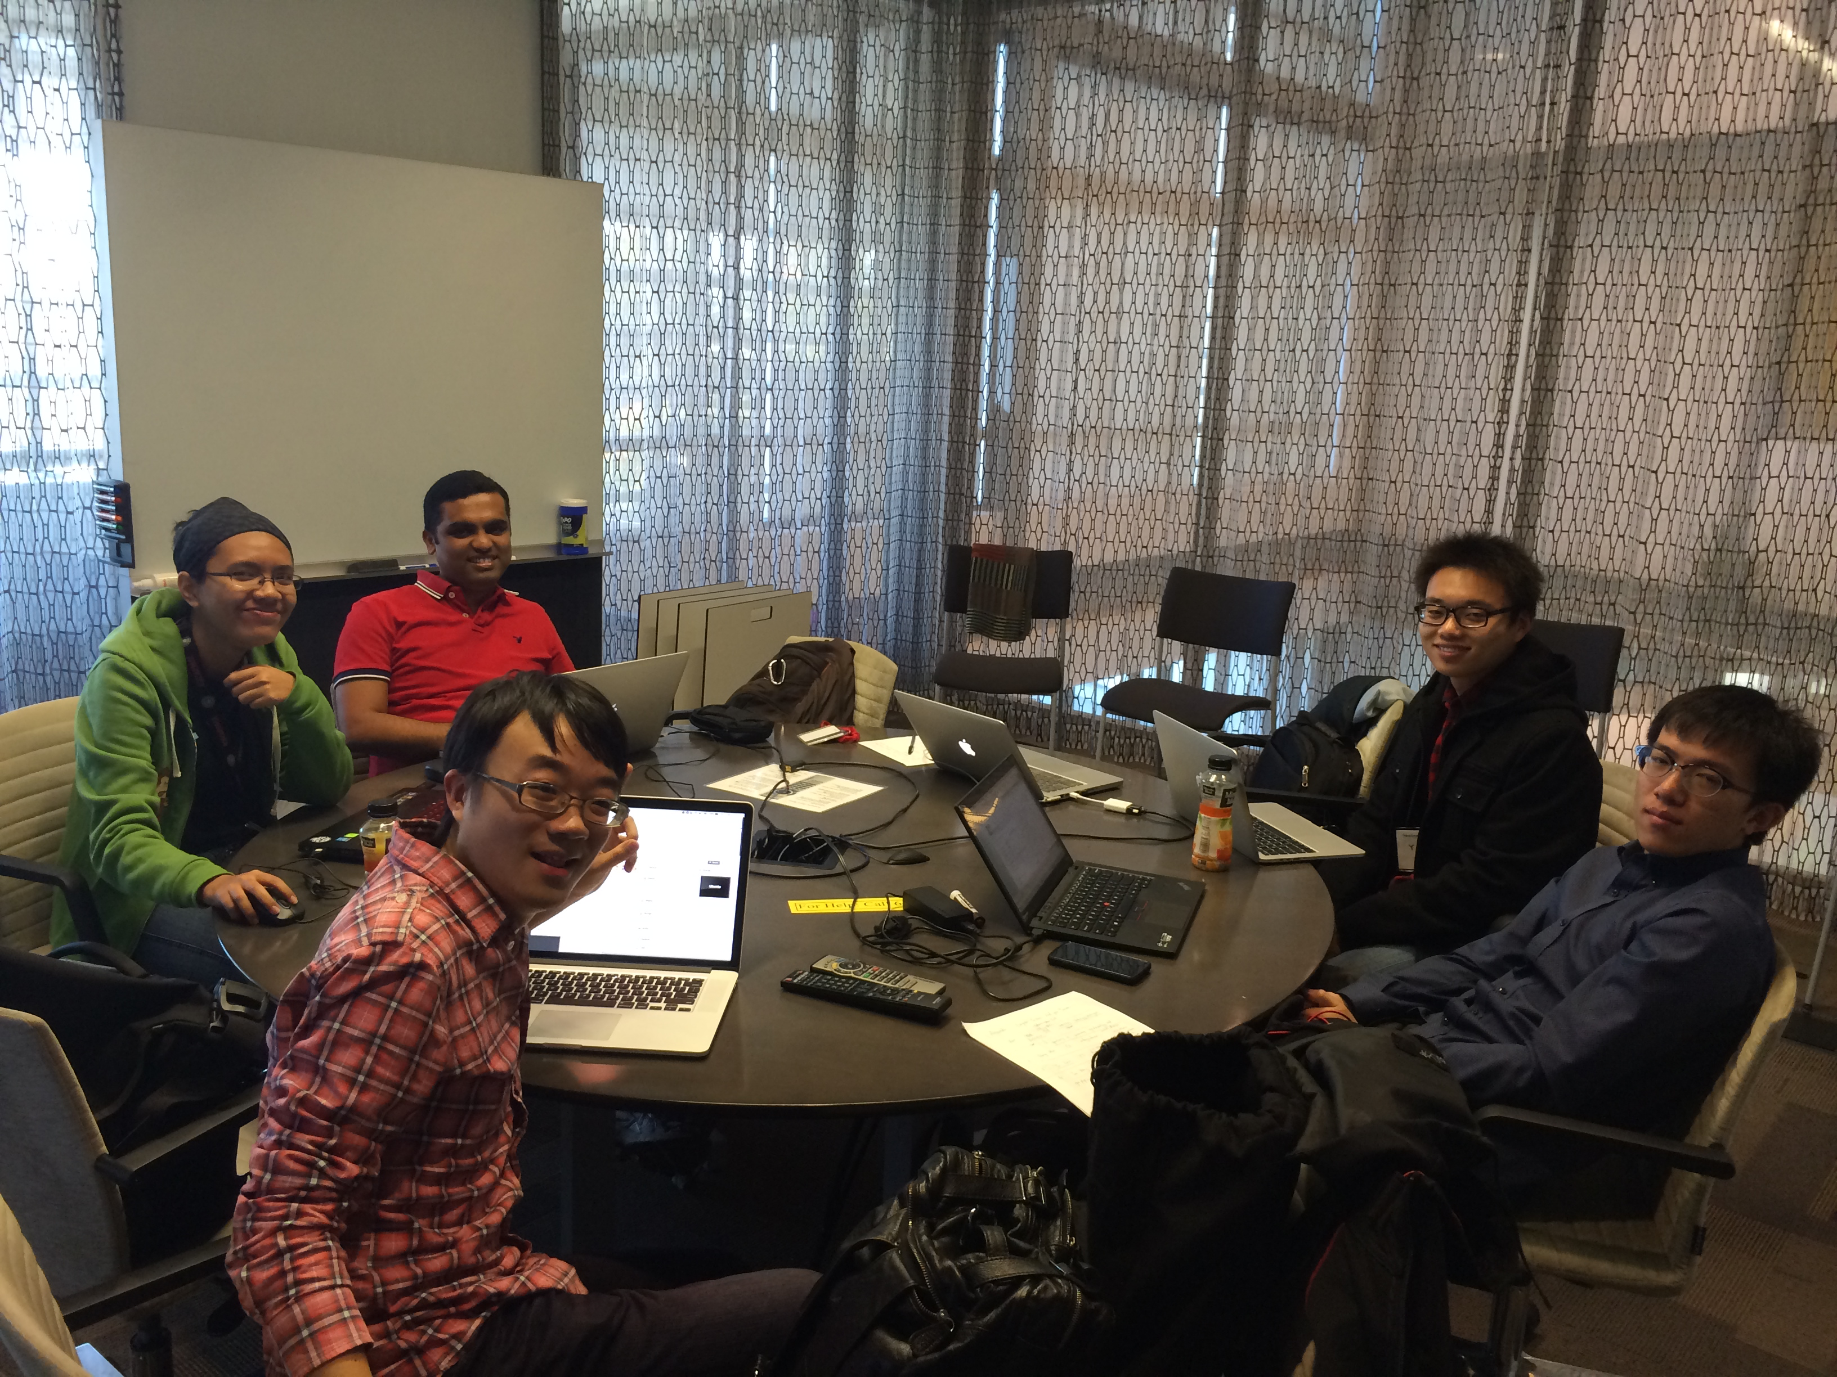
Students Expedition Challenge
The 5th student workshop ,Bloomington, IN, US

Slide 8
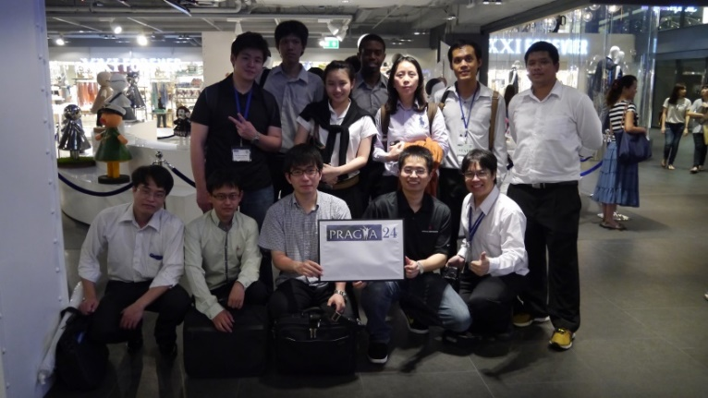
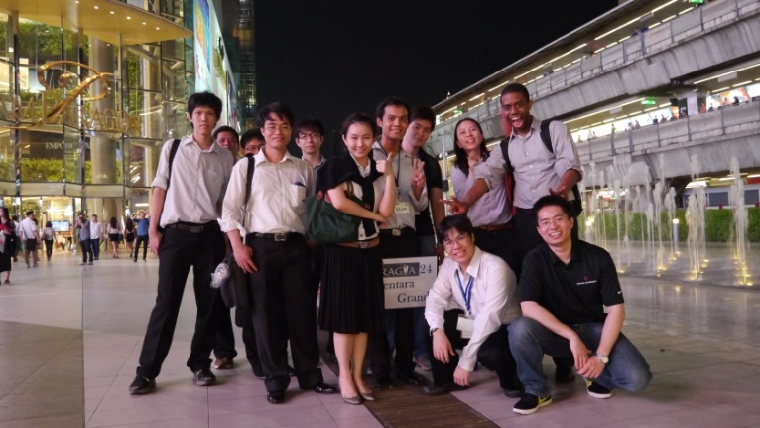
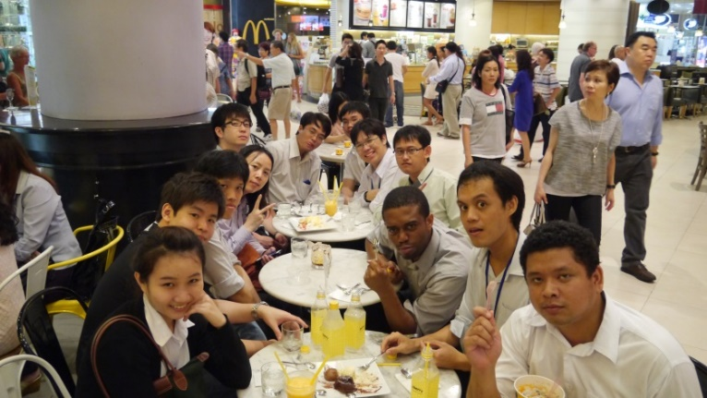
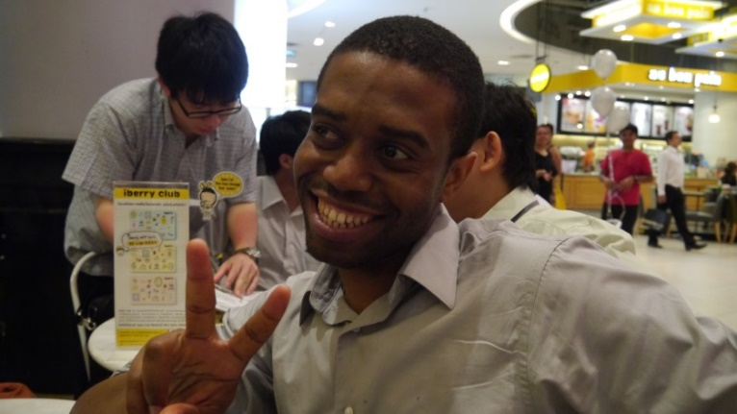
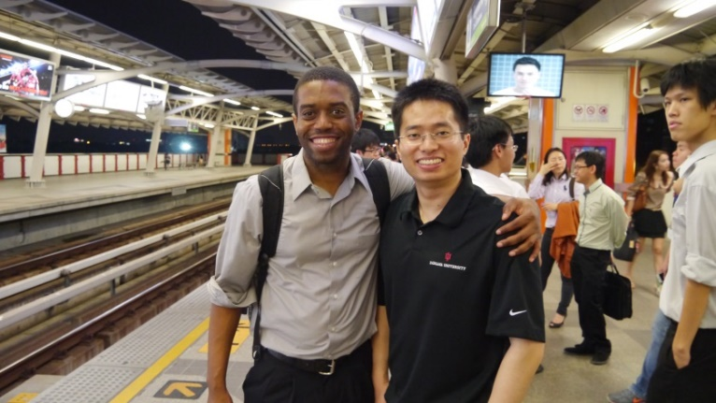
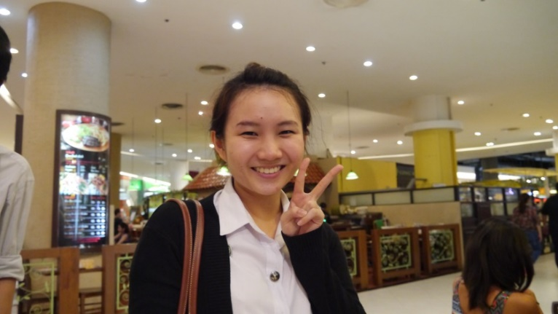
Informal trips/events

Slide 9
PRAGMA 28 – Poster Session
Primary Author | Institute | Title
Wanida Putthividhya | Thammasat University | The prototype of Fine-Grained Bandwidth-Allocating Middleware in Software-Defined Networks
Taweesil Wongratchatapokai | Thammasat University | A simulation study of time-limited VM migration scheduling in WANs
Yinling An | Konkuk University | A Linked Data based Approach to A Carbohydrate Complexation Database
Meilan Jiang | Konkuk University | Data Management system for The NAEMP in Korea
Renato Figueiredo | University of Florida | IPOP: A Peer-to-Peer Overlay Virtual Network
Quan Zhou | Indiana University Bloomington | A PROV pingback Model For Komadu Provenance System
Hiroki Ohtsuji | University of Tsukuba | Pipelined Data Processing Architecture for Network Storage Systems
Morsalin Uz Zoha | Osaka University | Research on Visualization Cloud for Scientific Research Collaboration by Leveraging Network-streamed Tiled Display Wall
Masaharu Shimizu | Osaka University | A Study on Dynamic Routing Functionality for SAGE Application Properties
Arata Endo | Osaka University | Improvement of Scalability in Sharing Application Screens between Tiled Display Walls
Jingai Ryoichi | Osaka University | Development of graph visualization application for adapting tiled display
Keichi Takahashi | Osaka University | Control Sequence Generator for Generic SDN-enabled MPI Framework
Che Huang | Nara Institute of Science and Technology | A Multipath Controller for Accelerating GridFTP Transfer over SDN
Chawanat Nakasan | Nara Institute of Science and Technology | Development of a Simple Multipath OpenFlow Controller for Multipath TCP
Pongsakorn U-chupala | Nara Institute of Science and Technology | Deployment and evaluation of Bandwidth and Latency Aware Network over Large-Scale OpenFlow testbed
Kar Long Chan | Nara Institute of Science and Technology | A Hybrid game contents streaming method to improve graphic quality delivered by cloud gaming
Kazuki Hara | Nara Institute of Science and Technology | netspec: Network Test Tool for Software-Defined Network
Xuliang Wang | Nara Institute of Science and Technology | An OpenFlow-based Flow-level Traffic Optimization

Slide 10
PRAGMA28 - Students Workshop
Apr. 8th, 2015, Osaka, Japan
09:00am – 09:15am : Introduction and Welcome
09:15am – 10:15am : Invited Talks
9:15am-9:35am : Kohei Ichikawa, NAIST
9:35am-9:55am : Nadya Williams, SDSC
9:55am-10:15am : Beth Plale, IUB
10:15am – 11:15am : Lightning Talks
11:15am – 11:20am : PRAGMA Student Committee Candidates’ Self-Introduction
11:20am – 11:30am : Wrap-up session
Notes:
For a student group to be strong, it must have support by senior members of the PRAGMA community, and must more strongly relate to the student’s educational
and research obligations in his/her home institution. The below platform of four thrusts is a proposal to engage senior PRAGMA members and better align the PRAGMA student group for long term success.

Slide 11
Lightening Talks List
Presenter | Institute | Title
Meilan Jiang | Konkuk University | Data Management system for The NAEMP in Korea
Kazuki Hara | Nara Institute of Science and Technology | netspec: Network Test Tool for Software-Defined Network
Yinling An | Konkuk University | A Linked Data based Approach to A Carbohydrate Complexation Database
Taweesil Wongratchatapokai | Thammasat University | A simulation study of time-limited VM migration scheduling in WANs
Keichi Takahashi | Osaka University | Control Sequence Generator for Generic SDN-enabled MPI Framework
Quan Zhou | Indiana University Bloomington | Linking Scientific Data using Pingback and Komadu
Che Huang | Nara Institute of Science and Technology | A Multipath Controller for Accelerating GridFTP Transfer over SDN Japan
Vasuwat Tan-anannuwat | Thammasat University | The prototype of Fine-Grained Bandwidth-Allocating Middleware in Software-Defined Networks
Kar Long Chan | Nara Institute of Science and Technology | A Hybrid game contents streaming method to improve graphic quality delivered by cloud gaming
Hiroki Ohtsuji | University of Tsukuba | Pipelined Data Processing Architecture for Network Storage Systems

Slide 12
Lightning Talk Voting
There will be 3 awards
Best presentation
Best technique
Best idea
Please participate by voting for your favorite talk in each category
Voting URL: http://twtsurvey.com/d5rb7uv6f9q8zj3

Slide 13
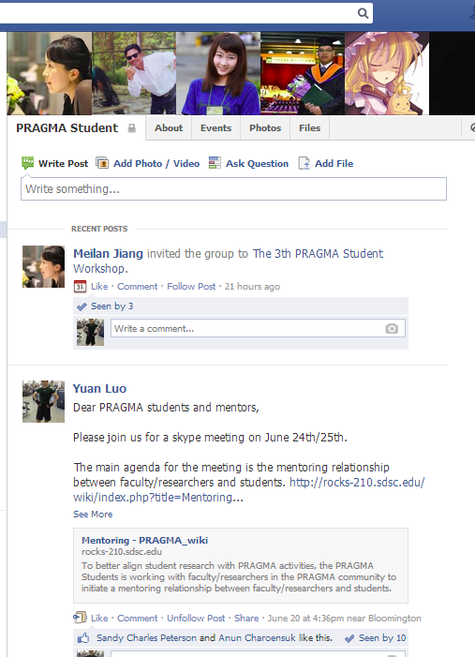
Join Us!
To subscribe, email to
pragma-student-list+subscribe@googlegroups.com (discussion)
pragma-students-announcements+subscribe@googlegroups.com (public announcements)

